Slide 1
Better Suburbs Forum
City Services overview – Intro to Slow Dialogue session
Jim Corrigan/ Ben McHugh
Transport Canberra and City Services

Slide 2
V
Who is City Services Division?
Capital projects
worth about
$100m (average) a year
- mostly roads
Total operating budget
around $370m
Manage assets valued at
$9 billion
Most are hard assets – roads, bridges paths and stormwater
700 staff
36% of TCCS workforce
….Top categories
Streetlight outages
Potholes
Trees and shrub issues
Mowing
Footpaths
We receive almost 50,000 requests for service per year…..
Around 1500 complaints
….prioritised according to safety and welfare concerns
Decisions on resource allocation based upon risk….

Slide 3
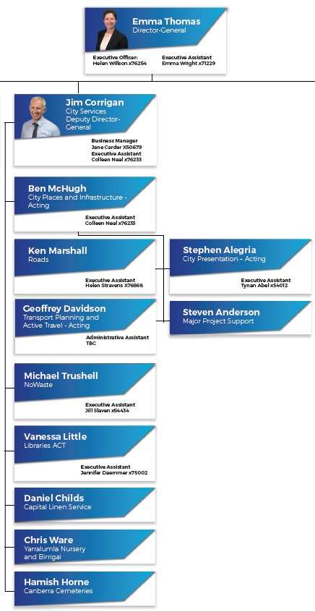
Structure
Joined 1 July 2018
Enablers
Out of scope
Out of scope – corporate enterprises

Slide 4
Main expense areas
Enablers

Slide 5
Community Lifestyle Services
Domestic animals
Parks and public amenity
Sporting & recreational facilities
General Services and Infrastructure
Roads – construction and maintenance
Traffic management
Street lighting
Waste management
Shopping precincts
Stormwater management
Footpaths and cycle paths – construction and maintenance
Trees & shrubs
Library services
Business activity
Presented in different ways
Two servicing streams
OR
Outcome clusters
Moving around
Caring for the Environment
Using land
Supporting people and animals
Morning session
Afternoon session

Slide 6
Moving around
Maintain roads and paths
Equips roads with signs and street lights
Roads
Mynul
Create connected travel routes, via community path network
Make decisions about road and path surfaces, speed limits and crossings
Morning session
Footpaths, Verges and nature strips
Neil, Darren
Traffic calming devices such as roundabouts, traffic lights and speed humps
Manage roads and paths to promote safety and adhere to national standards
Streetlights
Noreen
Schedule roadworks for upgrades and pothole repairs while managing traffic safely
Compliance for nature strip permits

Slide 7
Caring for the Environment
Household waste and recycling
Michael and Greg
Assess trees for health and safety, remove trees if required
Manage lakes, ponds wetlands and stormwater channels for healthy waterways
Public spaces waste and recycling
Patrick
Morning session
Fix damage caused by tree roots from trees on unleased land
Collection of household waste and recycling
Lakes, ponds, stormwater, water quality
Jennie and Joel
Plant, water, prune and remove branches from public trees
Treat soil and trees to reduce diseases and pests, weeds program
Street and park trees
Rachael and Carma

Slide 8
Using land
Playgrounds
Stephen and Lawrence
Manage public parks, local open space – mowing, weeding programs
Manage and maintain play spaces including
playgrounds and natural play spaces
Afternoon session
Parks and open space incl mowing
Jane
Provide and clean public amenities including benches, tables, BBQs, drinking fountains and shade structures
Enforce compliance for illegal dumping and abandoned vehicles on public land
included in Moving around
Manage and maintain recreational facilities including fitness stations, skate parks, dog parks
Community ovals
Mick
Manage and maintain community sporting ovals and amenities
Repairs to potholes

Slide 9
Supporting people and animals
Shopping Centre experience
Di and Ben
Provide library services – encourage literacy, learning and the pleasure of reading
Remove graffiti, litter pick, empty public bins, maintain public toilets
Library services
Vanessa and Sarah
Afternoon session
Promote responsible dog ownership and manage animal pound
Graffiti and community engagement
Patrick
Clean, maintain and upgrade public land at shopping centres
Manage amenity at shopping centres such as parking, landscaping, bike racks, water fountains, street furniture
Responsible pet ownership
Sean
Repairs to potholes

Slide 10
Q & A

